Slide 1
SCBI
Harvard Forest
Leaf stage
Woody Growth

Slide 2
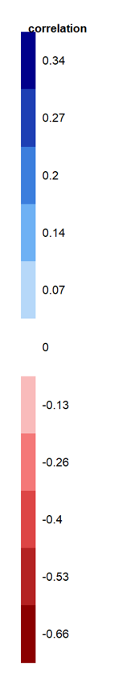
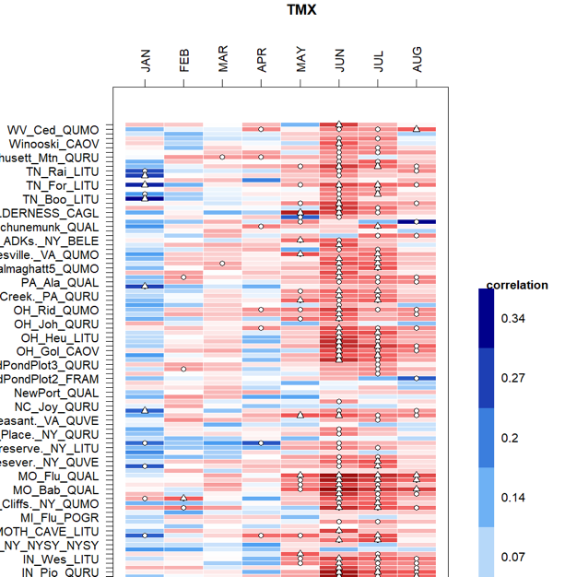
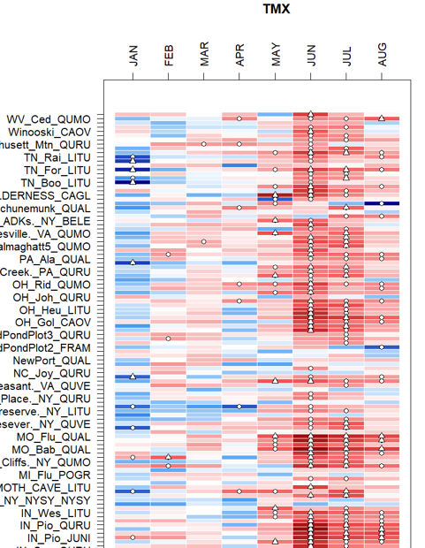
Other sites (ordered by mean April T or leaf phenology)– axis labels numbers

Slide 3
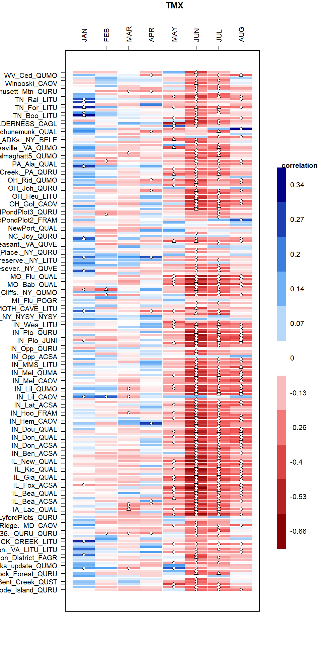
Other sites (ordered by mean April T or leaf phenology). Axis

